Slide 1

S&P 500 Analysis

Slide 2

Executive Summary
Summary of methodologies
Data collection with Python yfinance module
Data wrangling to transform data for better analysis
Exploratory data analysis (EDA) using SQL and Pandas
Data visualization with plots and charts
What I’ve found
Amount of positive and negative return days
Day of the week that most times had a negative return
Day of the week that most times had a positive return
20 worst days for the market since 2000
Months that contained most negative return days
Months that contained most positive return days

Slide 3
Introduction
Is monday really the worst day for the stock market? A lot of people say that it is. The goal of this project is to find that out, and if it really is the worse by how much.
This research analyzed S&P 500 data, which is an index that tracks the 500 biggest companies in the US stock market. The data used in the project starts in the first trading day of the year 2000.

Slide 4
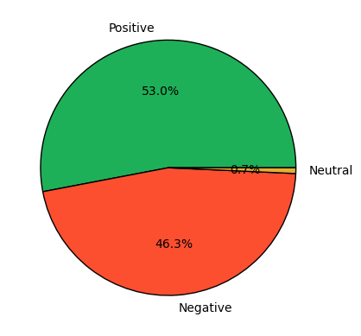
Positive, negative and neutral days
Out of the days observed 53% had positive returns, 46.3% had negative returns and 0.7% were neutral.

Slide 5
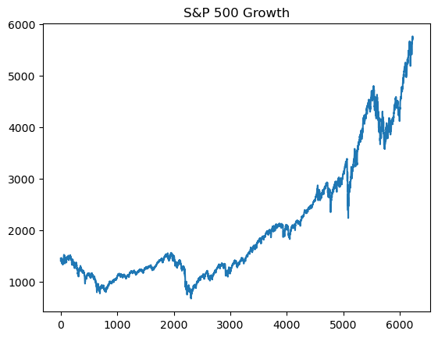
S&P 500 growth since 2000
Even though 46.3% of the days had a negative return the index still performed really well, it grew almost 300%.

Slide 6
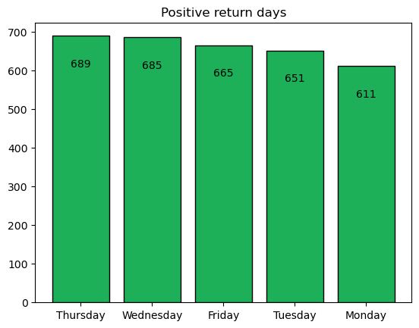
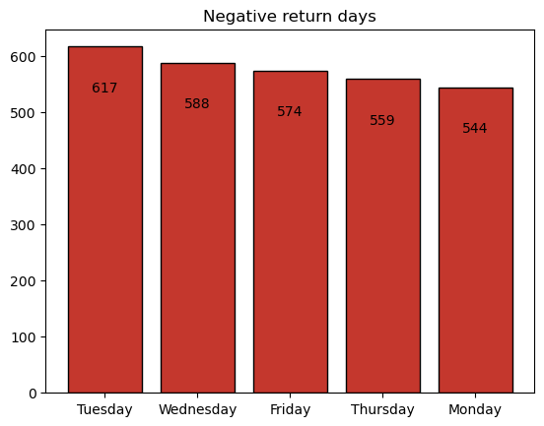
Count of positive and negative days (Day of the week)
These are the days with more negative return occurrences, Tuesday had most of the negative return days. Monday actually had less occurrences than any other day.
These are the days with more positive return occurrences, Thursday had most of the positive return days.

Slide 7
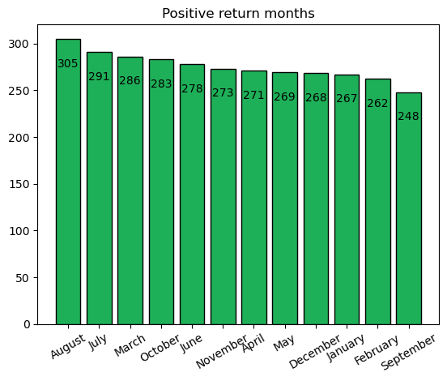
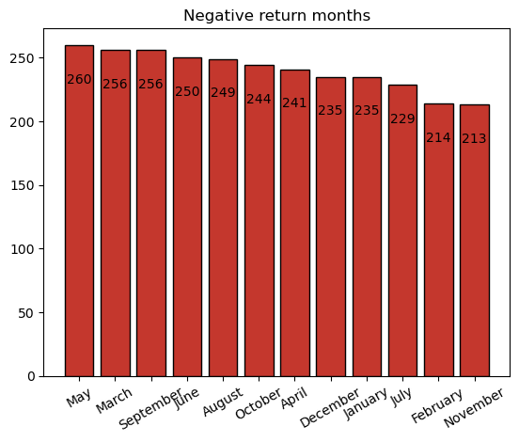
Count of positive and negative days (Month)
These are the months with more positive return occurrences, August had most of the positive return days.
These are the months with more negative return occurrences, May had most of the negative return days.

Slide 8
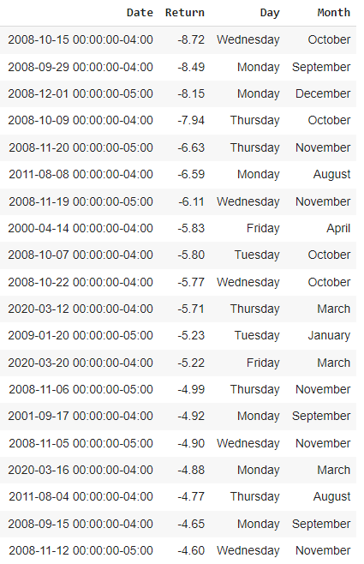
Ranking the worst days for the market
This is the list of the 20 days with the greatest percentage loss. Note that most of these days are from the 2008 financial crisis, the 2020 pandemic period is also present in the list. Between the greatest losses the day of the week with most occurrences is Monday.

Slide 9
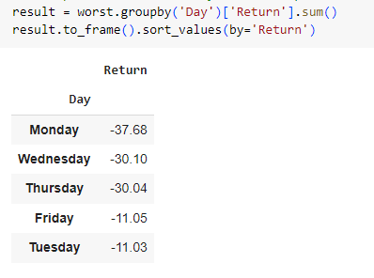
Return of the worst days for the market
Adding the losses of the 20 worst days of the period we can see that in fact monday had greater losses.

Slide 10
Conclusion
Although monday did not have the most occurrences of negative return days, among the 20 worst days it had the most occurrences and also the greatest percentage loss.
Out of the days observed 53% had positive returns, 46.3% had negative returns and 0.7% were neutral.
Thursday had most of the positive return days while Tuesday had most of the negative return days.
August had most of the positive return days while May had most of the negative return days.
The S&P 500 proved to be a great index for investments since it has grown since the year 2000.

Slide 11
Appendix
The notebook with all the project code can be found on Github:
https://github.com/awesomegab/S-P500_Analysis
LinkedIn:
www.linkedin.com/in/gabriel-melo-72ba8524a
Gabriel Silva de Melo

Slide 12
Thank you!

